Slide 1
Hamiltonian Simulation by QSP
Sharan Krishnan

Slide 2
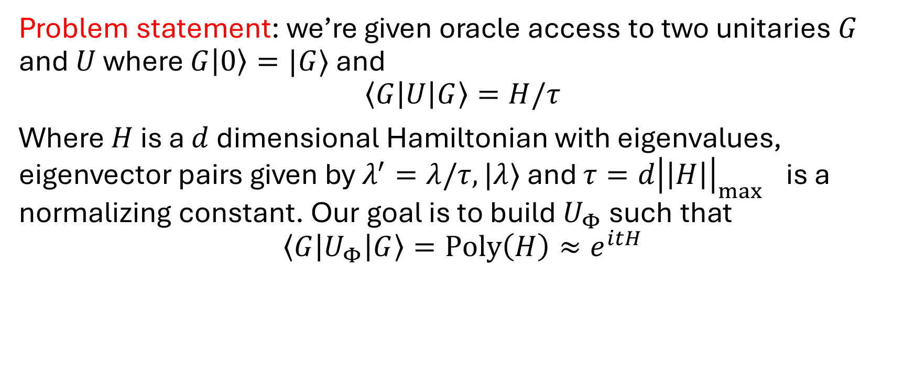
Simulation by Qubitization I
Problem statement: we’re given oracle access to two unitaries $G$ and $U$ where $G\left|0\right\rangle =|G⟩$ and
$$\left\langle G\left|U\right|G\right\rangle =H/τ$$
Where $H$ is a $d$ dimensional Hamiltonian with eigenvalues, eigenvector pairs given by $λ^{′}=λ/τ,|λ⟩$ and $τ={d\left|\left|H\right|\right|}_{\max{ }}$ is a normalizing constant. Our goal is to build $U_{Φ}$ such that
$$\left\langle G\left|U_{Φ}\right|G\right\rangle =Poly\left(H\right)≈e^{itH}$$

Slide 3
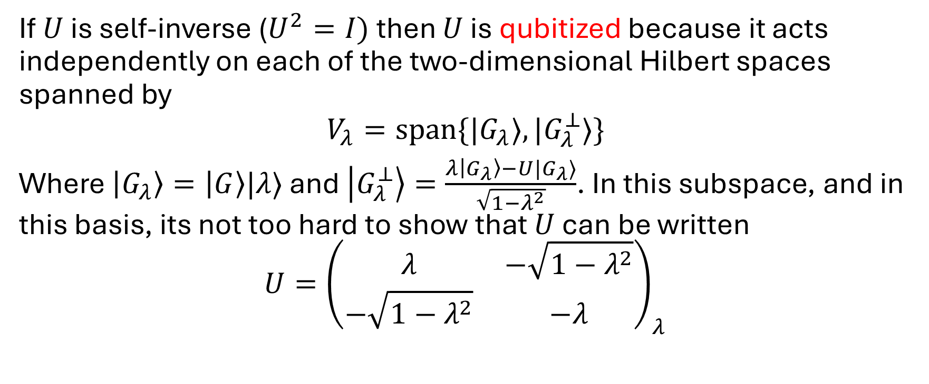
Simulation by Qubitization II
If $U$ is self-inverse ($U^{2}=I)$ then $U$ is qubitized because it acts independently on each of the two-dimensional Hilbert spaces spanned by
$$V_{λ}=span\{|G_{λ}⟩, |G_{λ}^{⊥}⟩\}$$
Where $\left|G_{λ}\right\rangle =\left|G\right\rangle |λ⟩$ and $\left|G_{λ}^{⊥}\right\rangle =\frac{λ\left|G_{λ}\right\rangle −U|G_{λ}⟩}{\sqrt{1−λ^{2}}}$. In this subspace, and in this basis, its not too hard to show that $U$ can be written
$$U={\left(\begin{matrix}λ & −\sqrt{1−λ^{2}} \\ −\sqrt{1−λ^{2}} & −λ\end{matrix}\right)}_{λ}$$

Slide 4
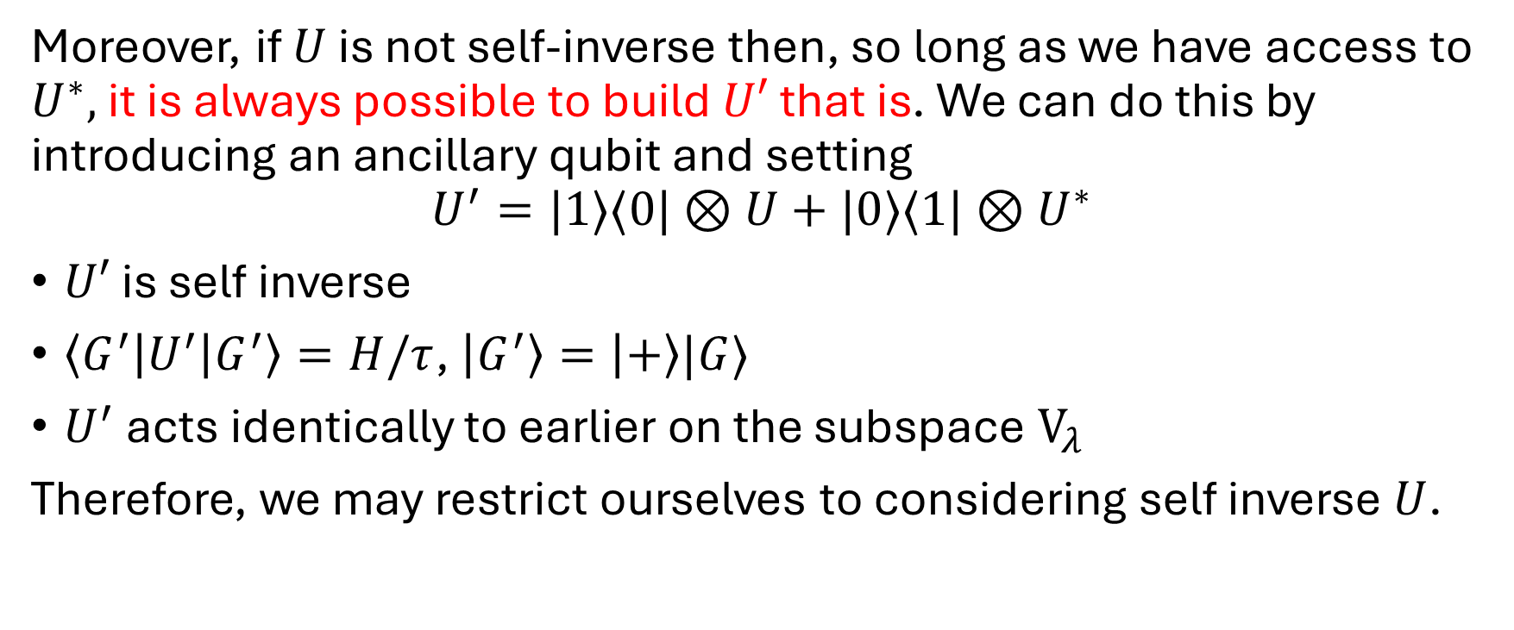
Simulation by Qubitization III
Moreover, if $U$ is not self-inverse then, so long as we have access to $U^{∗},$ it is always possible to build $U′$ that is. We can do this by introducing an ancillary qubit and setting
$$U^{′}=|1⟩⟨0|⊗U+|0⟩⟨1|⊗U^{∗}$$
$U′$ is self inverse
$\left\langle G^{′}\left|U^{′}\right|G^{′}\right\rangle =H/τ$, $\left|G^{′}\right\rangle =\left|+\right\rangle |G⟩$
$U^{′}$ acts identically to earlier on the subspace $V_{λ}$
Therefore, we may restrict ourselves to considering self inverse $U$.

Slide 5
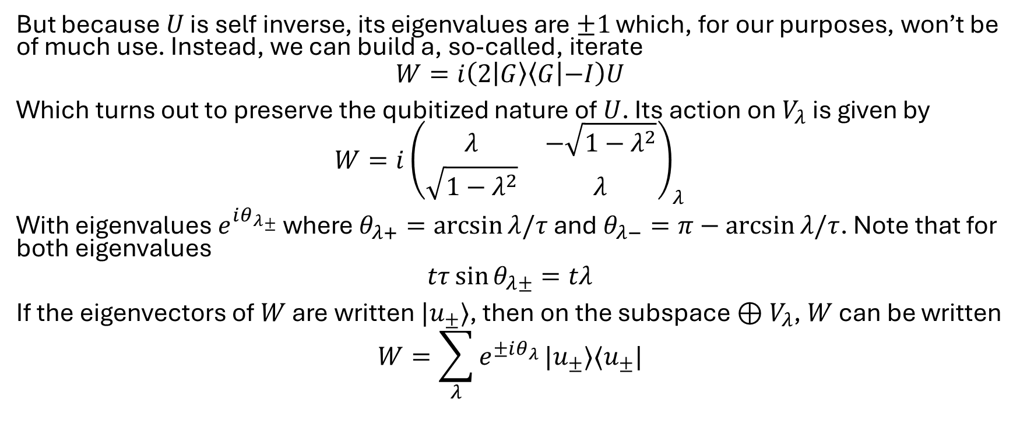
Simulation by Qubitization IV
But because $U$ is self inverse, its eigenvalues are $±1$ which, for our purposes, won’t be of much use. Instead, we can build a, so-called, iterate
$$W=i\left(2 | G\right\rangle \left\langle G | −I\right)U$$
Which turns out to preserve the qubitized nature of $U$. Its action on $V_{λ}$ is given by
$$W={i\left(\begin{matrix}λ & −\sqrt{1−λ^{2}} \\ \sqrt{1−λ^{2}} & λ\end{matrix}\right)}_{λ}$$
With eigenvalues $e^{i{θ_{λ}}_{±}}$ where $θ_{λ+}=\arcsin{λ/τ}$ and $θ_{λ−}=π−\arcsin{λ/τ}$. Note that for both eigenvalues
$$tτ\sin{θ_{λ±}}=tλ$$
If the eigenvectors of $W$ are written $|u_{±}⟩$, then on the subspace $⊕V_{λ}$, $W$ can be written
$$W=\sum_{λ}{e^{±iθ_{λ}}}|u_{±}⟩⟨u_{±}|$$

Slide 6
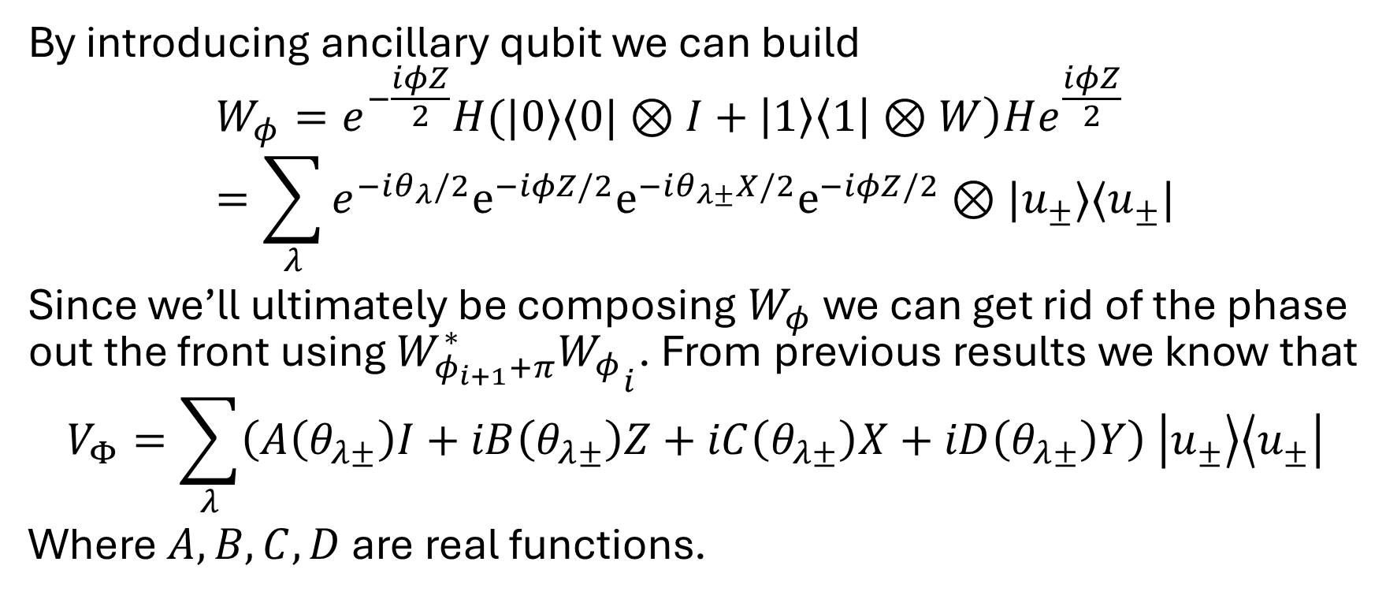
Simulation by Qubitization V
By introducing ancillary qubit we can build
$$W_{φ}=e^{−\frac{iφZ}{2}}H(|0⟩⟨0|⊗I+\left|1\right\rangle \left\langle 1 | ⊗W\right)He^{\frac{iφZ}{2}} \\ =\sum_{λ}{e^{−iθ_{λ}/2}e^{−iφZ/2}e^{−iθ_{λ±}X/2}e^{−iφZ/2}⊗|u_{±}⟩⟨u_{±}|}$$
Since we’ll ultimately be composing $W_{φ}$ we can get rid of the phase out the front using ${W_{φ_{i+1}+π}^{∗}W_{φ}}_{i}$. From previous results we know that
$$V_{Φ}=\sum_{λ}{\left(A\left(θ_{λ±}\right)I+iB\left(θ_{λ±}\right)Z+iC\left(θ_{λ±}\right)X+iD\left(θ_{λ±}\right)Y\right) \left|u_{±}\right\rangle \left\langle u_{±}\right|}$$
Where $A,B,C,D$ are real functions.

Slide 7
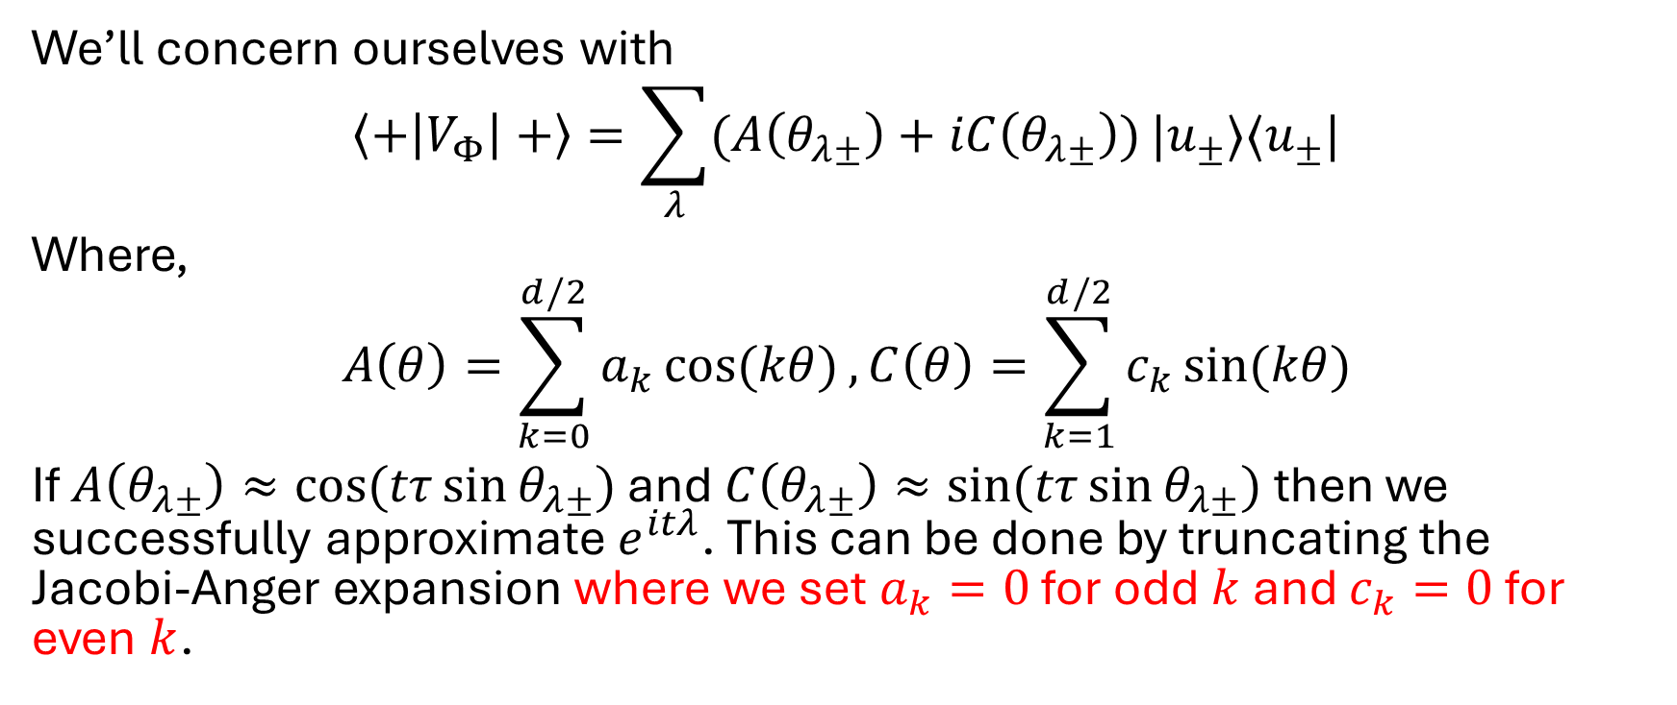
Simulation by Qubitization VI
We’ll concern ourselves with
$$\left\langle +\left|V_{Φ}\right|+\right\rangle =\sum_{λ}{(A\left(θ_{λ±}\right)+iC\left(θ_{λ±}\right))}|u_{±}⟩⟨u_{±}|$$
Where,
$$A\left(θ\right)=\sum_{k=0}^{d/2}{a_{k}\cos{(kθ)}}, C\left(θ\right)=\sum_{k=1}^{d/2}{c_{k}\sin{(kθ)}}$$
If $A\left(θ_{λ±}\right)≈\cos{(tτ\sin{θ_{λ±}})}$ and $C\left(θ_{λ±}\right)≈\sin{(tτ\sin{θ_{λ±}})}$ then we successfully approximate $e^{itλ}$. This can be done by truncating the Jacobi-Anger expansion where we set $a_{k}=0$ for odd $k$ and $c_{k}=0$ for even $k$.

Slide 8
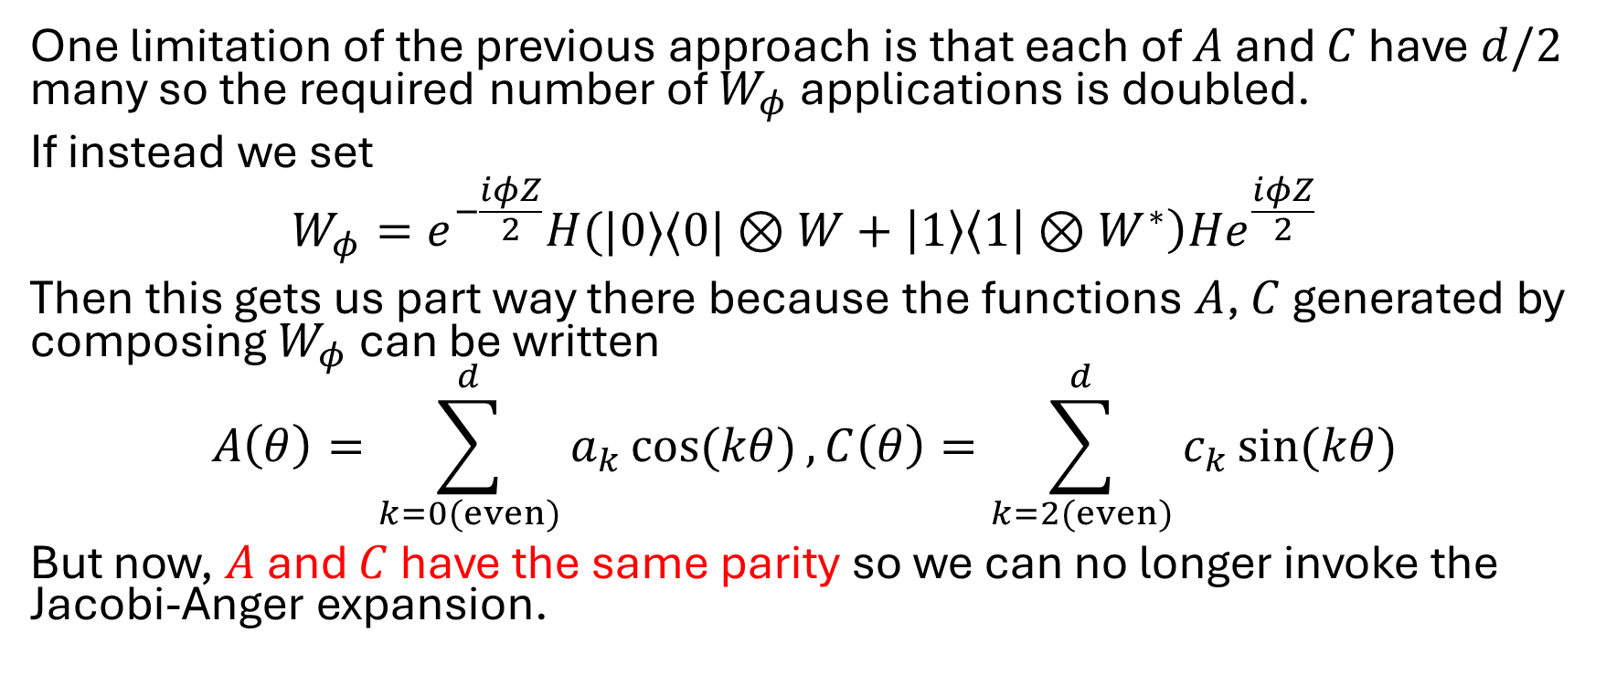
Doubling the efficiency I
One limitation of the previous approach is that each of $A$ and $C$ have $d/2$ many so the required number of $W_{φ}$ applications is doubled.
If instead we set
$$W_{φ}=e^{−\frac{iφZ}{2}}H(|0⟩⟨0|⊗W+\left|1\right\rangle \left\langle 1 | ⊗W^{∗}\right)He^{\frac{iφZ}{2}}$$
Then this gets us part way there because the functions $A$, $C$ generated by composing $W_{φ}$ can be written
$$A\left(θ\right)=\sum_{k=0(even)}^{d}{a_{k}\cos{(kθ)}}, C\left(θ\right)=\sum_{k=2(even)}^{d}{c_{k}\sin{(kθ)}}$$
But now, $A$ and $C$ have the same parity so we can no longer invoke the Jacobi-Anger expansion.

Slide 9
Doubling the efficiency II
Instead, we can use Generalised QSP which is a technique built on the results of qubitization and QSP that produces a more expressive set of polynomials.

